Slide 1
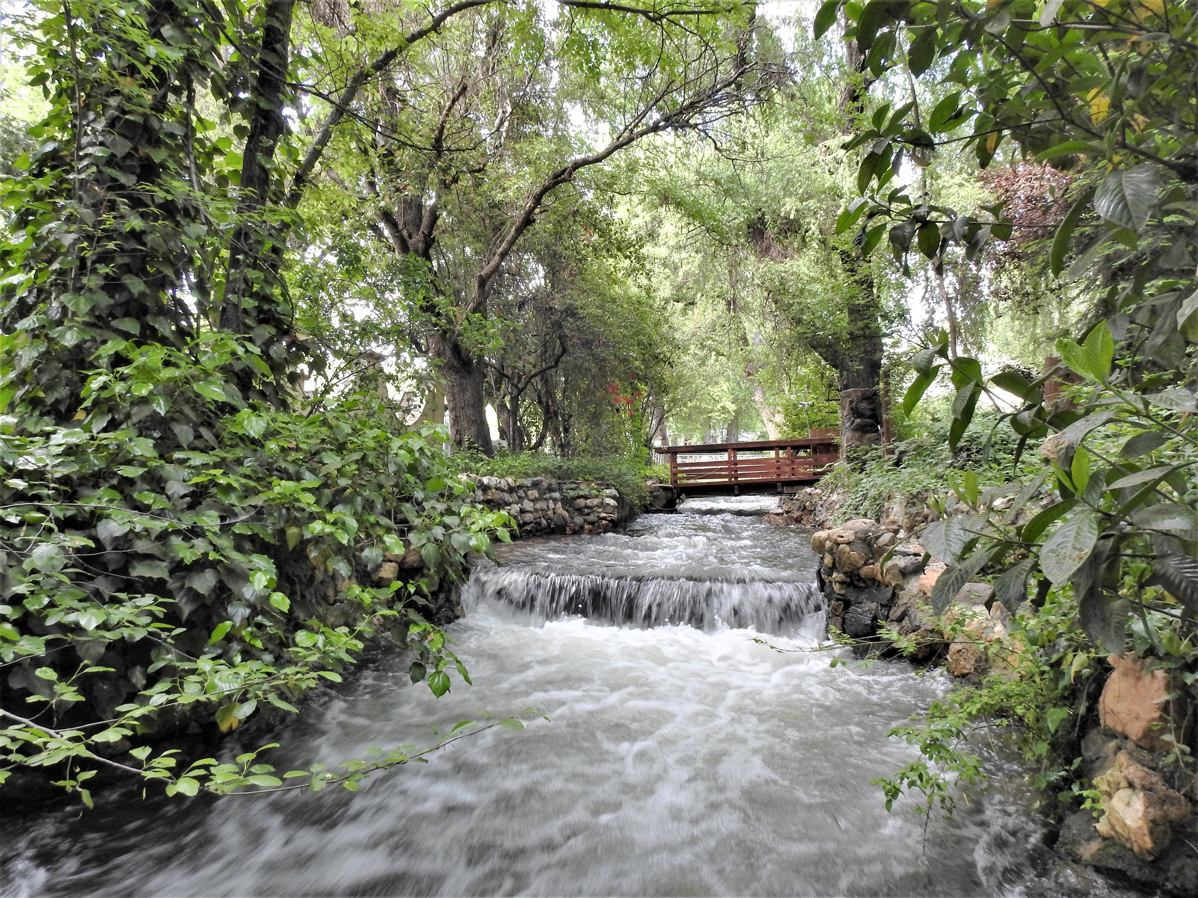

Utica Regular Board Meeting
August 25, 2026

Slide 2
Order of Business
Call to Order / Pledge of Allegiance
Roll Call

Slide 3
Item 3 – Approval of Agenda

Slide 4
Approval of Agenda
  Motion to approve agenda

Slide 5

Item 4 – Public Comment

Slide 6
Public Comment
  Comments are limited to three minutes per speaker.
  Members of the public may address the Board on any item not listed on the Agenda.
    Public comment on agendized items will be heard at the time the item is considered by the Board.
  The public is encouraged to work with staff to put future items on a regular meeting agenda for Board consideration.

Slide 7
Item 5 – Consent Calendar

Slide 8
Consent Calendar
Motion to approve the consent calendar

Slide 9
Item 6A – Capital Improvement Plan

Slide 10
Capital Improvement Plan
Motion to adopt Resolution 2026-10 Adopting the 2026-2033 Capital Improvement Plan
Roll Call Vote

Slide 11
Item 6B – UWPA Master Plan

Slide 12
UWPA Master Plan
Creates a 10 to 20-year framework for UWPA’s infrastructure, finances, risks, and regulatory requirements.
Addresses aging infrastructure, financial, and regulatory risks.
Guides the Strategic and Capital Improvement Plans.
Supports flexible, informed decision-making.
Requires Board review at least every 5 years.

Slide 13
UWPA Master Plan
Motion to adopt Resolution 2026-13 adopting the Utica Water and Power Authority Master Plan
Roll Call Vote

Slide 14
Item 6C – Monthly Financial Reports

Slide 15
Monthly Financial Reports
Reviewal of the financial reporting options presented and provide direction regarding the preferred format and level of detail for future Board financial reports.

Slide 16
Item 6D – Amending the Purchasing Policy

Slide 17
Amending the Purchasing Policy
Revisions provide a clearer and more consistent framework for purchasing.
Clarification of purchasing authority, strengthening of internal controls, and ensuring legal and procurement compliance.
Key changes: Updated procedures, formalized sole-source emergency purchases, enhanced documentation, and clearer guidance for staff.

Slide 18
Item 6E – Establish an Ad Hoc Committee for Member Agency Rate Considerations

Slide 19
Ad Hoc Committee for Member Agency Rate Considerations
Review rates and charges, including affordability, costs, reserves, capital needs, debt service, and future rate actions.
The committee cannot set rates or make commitments; recommendations will go before the full Board.
Initial report in 30 days. Final findings targeted within 90 days.

Slide 20
Item 7 – Correspondence, GM and Board Reports, Future Items

Slide 21
7A – Correspondence

Slide 22
7B – General Manager Report

Slide 23
7C – Board Member Agency Reports
City of Angels
Union Public Utility
At Large Director

Slide 24
7D – Future Agenda Items
FY 2025-2026 Budget Adjustment

Slide 25
Item 8 – Upcoming Meetings

Slide 26
Upcoming Meetings
Meeting Date:
  Tuesday, September 22, 2026, at 5:30 p.m.
  Tuesday, October 27, 2026, at 5:30 p.m.
  Tuesday, November 24, 2026, at 5:30 p.m. (consider rescheduling)

Slide 27
Item 9 - Adjournment

