Slide 1
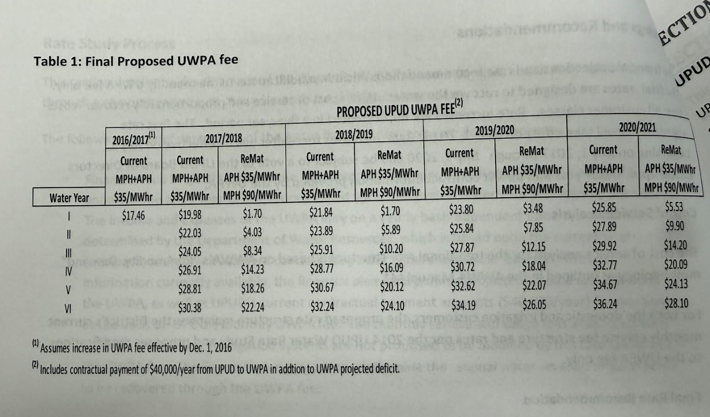
Weber, Ghio, and Associates, Inc. Water Rate Cost of Service Study UWPA Fee August 2016.
Showing $17.46 per month charge.
Source: https://www.uticawater.com/files/b4c74d2e2/2016+WGA+rate+study.pdf

Slide 2
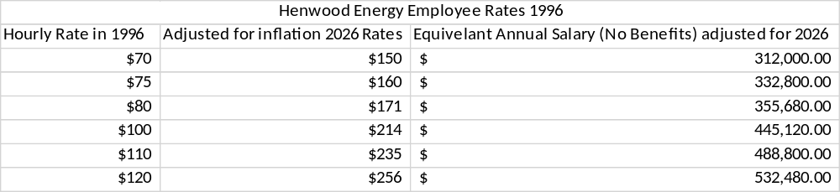
Henwood Energy Services, Inc.
February 21, 1996
Interim Assistance Angels/Utica Project Contract
Henwood employees per contract: 7
Utica Employees in 1996: 3
Total amount of employees (1996): 10
Current Utica staffing: 8 F/T 2 P/T
Services billed by hourly rate:
February 1996 Monthly billing:
Henwood Energy Services Billing Invoice
February billed amount: $36,800
Adjusted for inflation: $78,600 (not including 3 Utica Employees)
Utica 2026 monthly $53,873.18 payroll
Current Utica staffing is a savings of $24,726.82 per month versus the 1996 contracted rates (adjusted for inflation).

